Slide 1
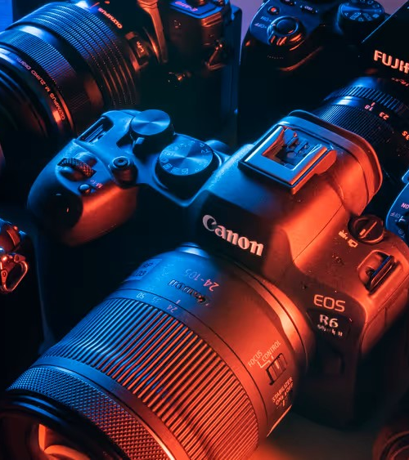
Source Camera Identification
BY
Kapil Raisinghani
&
Yash Mohan

Slide 2
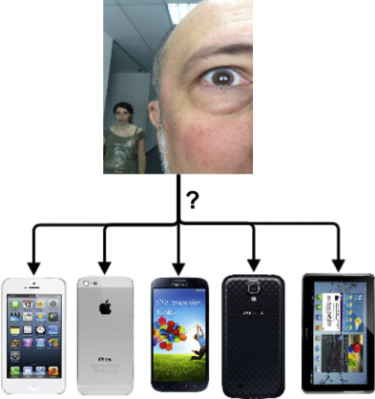
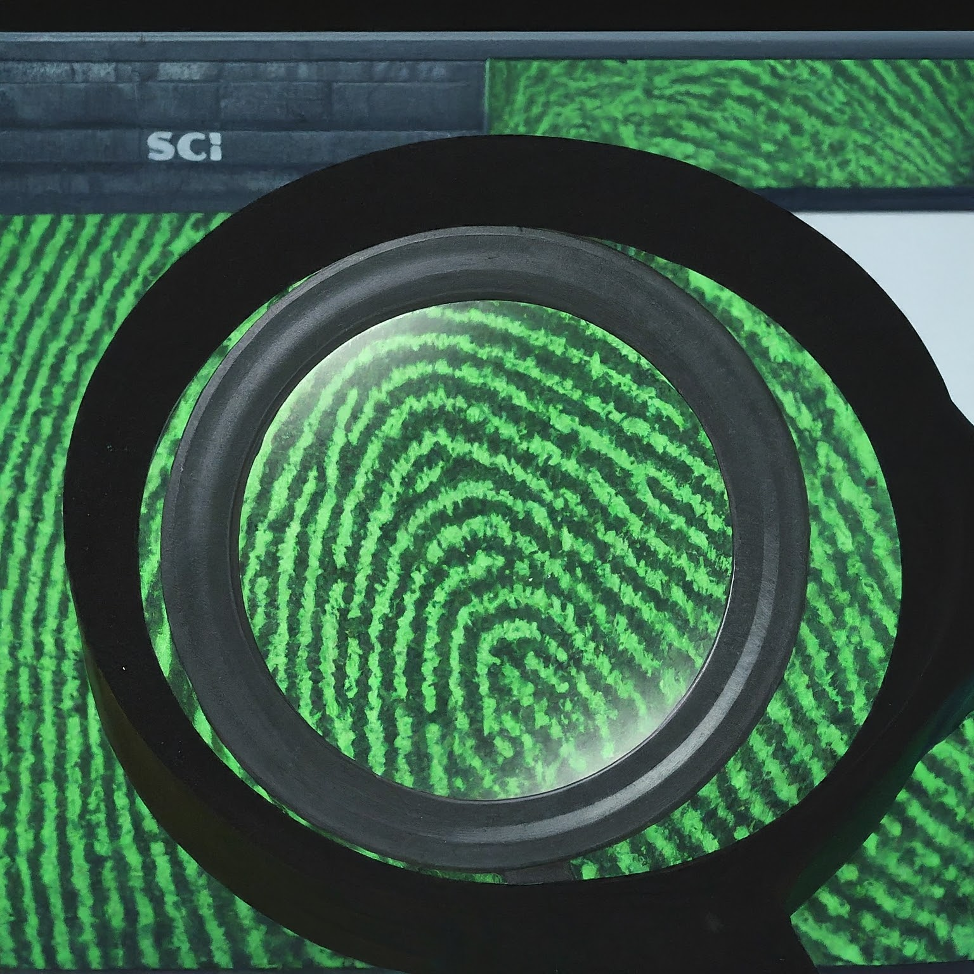
What is Source Camera Identification?
To use photos to predict the model of the device they were captured with.
Why do we need it?
We need Source Camera Identification to verify the authenticity of digital evidence.
By Identifying the camera used, SCI can help prove if images or videos are real or manipulated.
This is crucial for fighting fake news and online crime investigations.

Slide 3
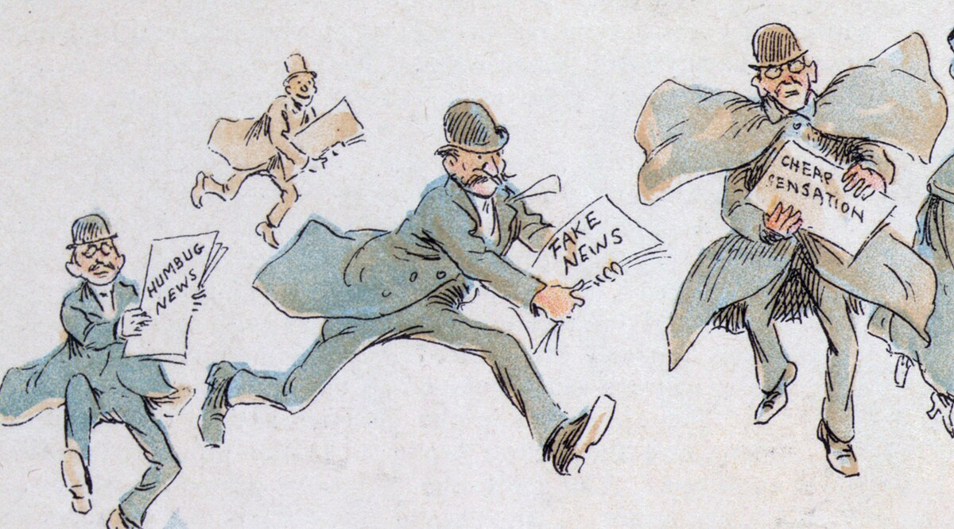
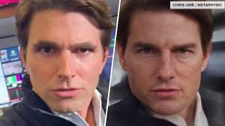
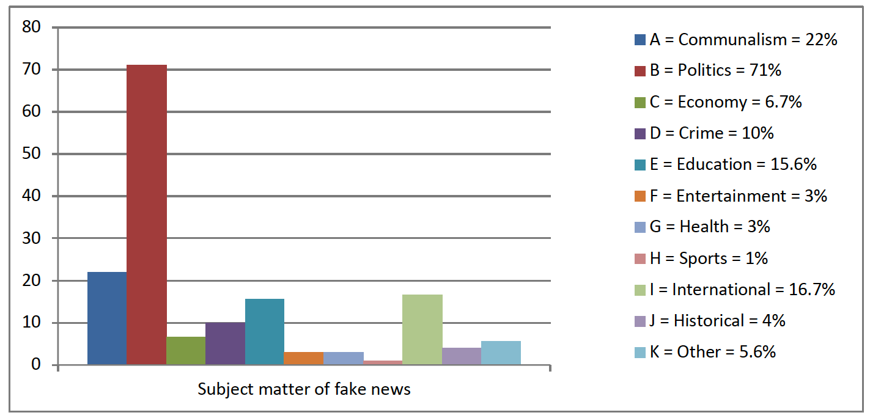
Motivation
Spreading of misinformation(fake images)
Identifying Deep Fakes
Political agenda/propaganda
Manipulation of public opinion

Slide 4
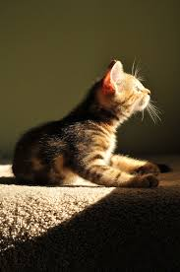
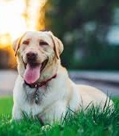


This slide captures the essence of the problem.
Normally CNNs are used to classify or detect what is in a picture.
This problem is however the other way round, regardless of what is in the picture,
We need to tell what camera was used to take it.
The challenge is to detect low level features, such as noise optical flaws and what is specific to the processing algorithm.
cat
dog
DSLR
PHONE

Slide 5
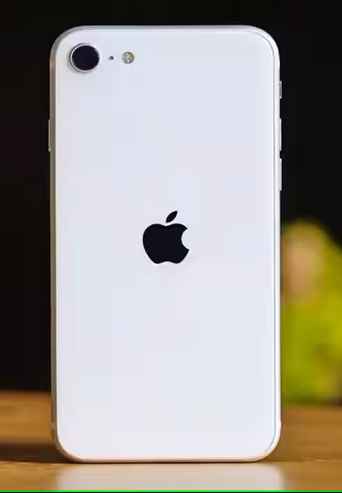

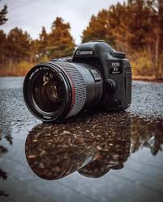
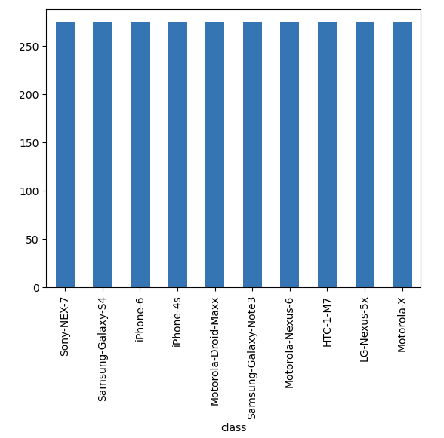
Dataset
Classes: 2x
7x
1x
Total models: 10 total images:10 x 275
Testing Data
Validation Data
Training Data

Slide 6
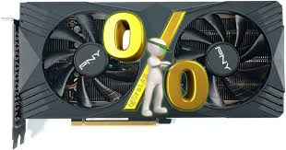
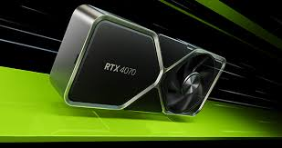
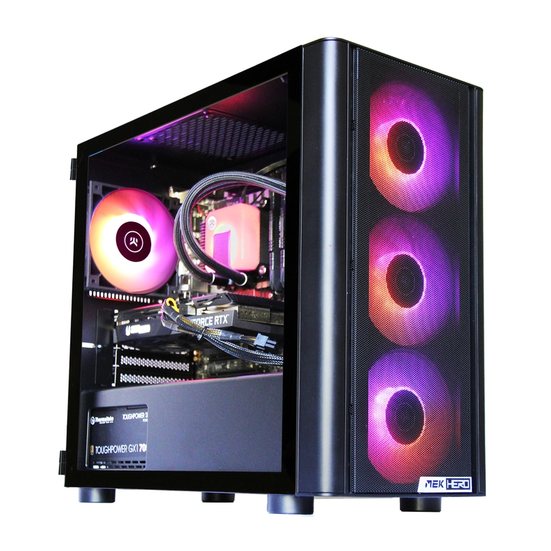
Hardware
Chip Type: NVIDIA GeForce RTX 4070
DAC Type: Integrated RAMDAC
Approx. Total Memory: 44353MB
Display Memory(VRAM): 12026MB
Shared Memory: 32327MB
Operating System: Windows 11 Pro 64-bit(10.0,Build 22621)
BIOS: 1636
Processor: AMD Ryzen 9 7950X 16-Core Processor(32 CPUs),~4.5GHz
Memory: 65536MB RAM
DirectX Version: DirectX12

Slide 7
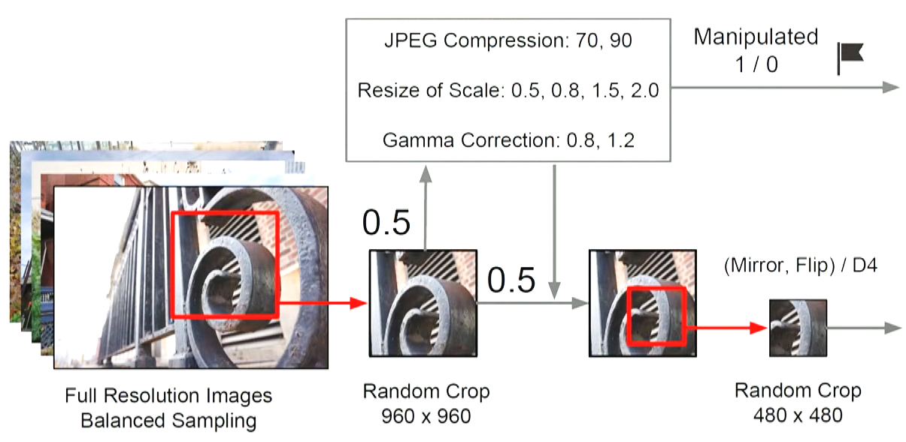
Preprocessing and Augmentation:
Manipulated
1/0
Removing irrelevant features
from the input data, enhances the model’s
ability to learn meaningful patterns.
JPEG Compression: 70, 90
Augmentation artificially
increases the size of the
dataset by applying random
transformation.
Resize the Scale: 0.5, 0.8, 1.5, 2.0
Gamma Correction: 0.8, 1.2
0.5
Preprocessed and Augmented
Final Training Image of size
512 x 512
(Mirror, Flip)/D4
0.5
Full Resolution Images
Balanced Sampling
Random Crop
512 x 512

Slide 8
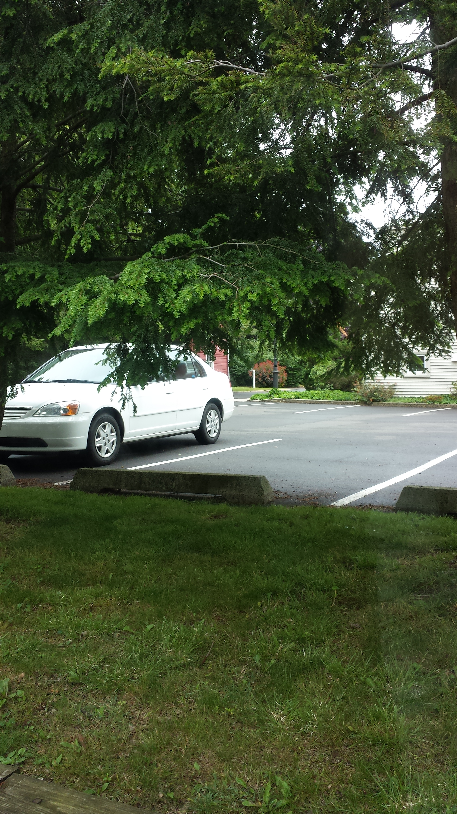
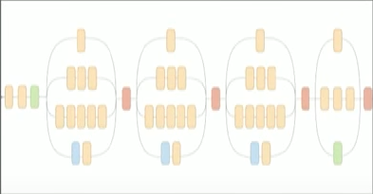
Model Architecture
Input Layer
Fully Connected Layer
Global Avg Pooling
Augmented and preprocessed image
512 x 512
Base Model - DenseNet201
Weights from ImageNet dataset
Output Layer- 10 units for
Multi-Class Classification and
Soft-max activation

Slide 9
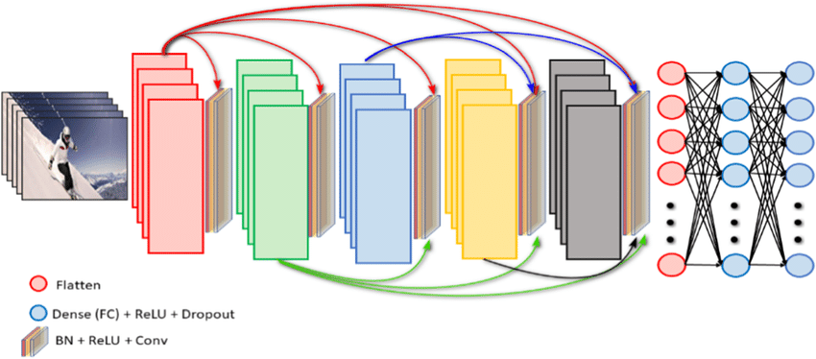
Base Model DenseNet201 (For Transfer Learning and Feature Extraction)
First step is to load the pre-trained DenseNet201 model which has already been trained on
a large dataset(ImageNet). This base model serves as a feature extractor, capturing low-level
features from input images.
Non-linear algorithms are applied to raw images before saving them to memory cards. These
steps are-
- Demosaicing Strategies- Interpolation of color information from the raw sensor data.
- Noise Characteristics- Unique Noise patterns during image capture.
- Lense Distortion Correction- Algorithms that compensate for lens distortions.
- Histogram Strategies- How pixel intensities are distributed in the image.
- Other camera specific processing steps.
We excluded the fully connected layers(top layers) of the original DenseNet201 leaving only the
convolutional layers.

Slide 10
Fine-tuning the base model(DenseNet201) to our requirements
We have set its training attribute to True. This means that during training, the weights of
the base model’s layers can be fine-tuned on our specific task i.e. Source Camera Identification.
Fine-tuning allows the model to adapt to the new dataset while retaining the knowledge learned
from ImageNet.
Applying Preprocessing specific to DenseNet201
This ensures that the input data is in the correct format expected by the model.
Example- pixel-scaling, mean subtraction

Slide 11
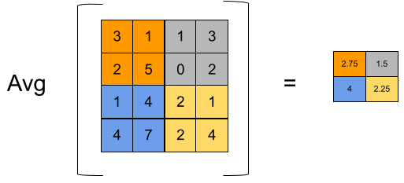
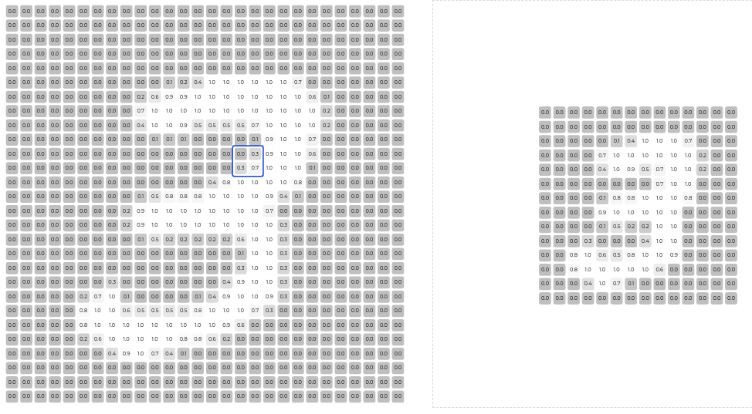
Global Average Pooling
Reduces spatial dimensions of the features map.
Computes average for each feature map across spatial dimensions.
Enables model to handle variable size input image.

Slide 12
Fully Connected Layer-1
Dense Layer(64 Units)
A fully connected layer with 64 units is added. This layer learns to combine the extracted features
into higher level representations.
ReLU activation function used introduces non-linearity.
Dropout Layer – (0.3)(x)
Regularizes the model by randomly dropping 30% of the neurons during training.
Helps prevent overfitting.
Improves generalization by reducing dependency on specific neurons.
Enhances model robustness.

Slide 13
Fully Connected Layer-2
Dense Layer(32 Units)
A fully connected layer with 32 units is added. This layer learns to combine the extracted features
into higher level representations.
ReLU activation function used introduces non-linearity.
Dropout Layer – (0.3)(x)
Regularizes the model by randomly dropping 30% of the neurons during training.
Helps prevent overfitting.
Improves generalization by reducing dependency on specific neurons.
Enhances model robustness.

Slide 14

Output Layer(10 units, Softmax Activation)
Final layer produces the model’s prediction.
It has 10 units as classification class is with 10 camera models.
The Soft-max Activation function converts raw scores into class probabilities.
Compile Model
We compiled the model using Adam Optimizer with learning rate 1e-6.
- Adam Optimizer- Ability to increase or decrease learning rate w.r.t step direction.
Used Loss Function-Categorical Cross-entropy(for multi-class classification).

Slide 15
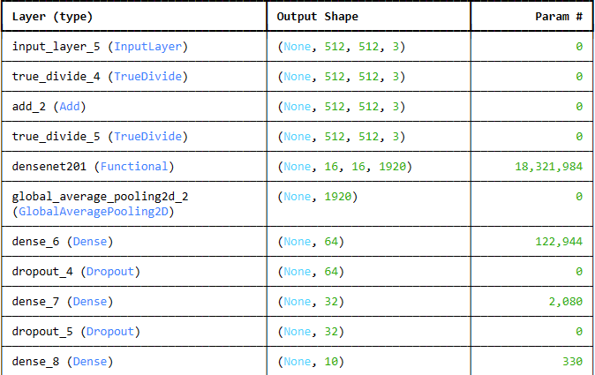

Compiled the model using Adam Optimizer with learning rate 1e-6
Loss Function- Categorical Cross-Entropy

Slide 16
Results

Slide 17
What’s next?
Using GPUs for faster training
Combining state of the art architectures(DenseNet161, ResNext101, SE-ResNet50, SE-ResNext50) for an ensemble
And Finally, the most important of all “Video Source Camera Model Identification”
Class 1
….
Class N
Aggregation of
Frame prediction
Input Video
Frame Extraction
Preprocess-ing
Ensemble Model

Slide 18
References
i.e.e.e. signal processing society – Dataset
Source camera identification techniques: A survey
Source camera identification from videos
PRNU-Net: A deep learning approach for source Camera model identification based on videos taken with smartphone
Source camera identification using image features

Slide 19
Thank You For Being An Awesome Audience!!!

